Slide 1
Secure Cloud Manufacturing
Routing Plan
Fall 2017

Slide 2
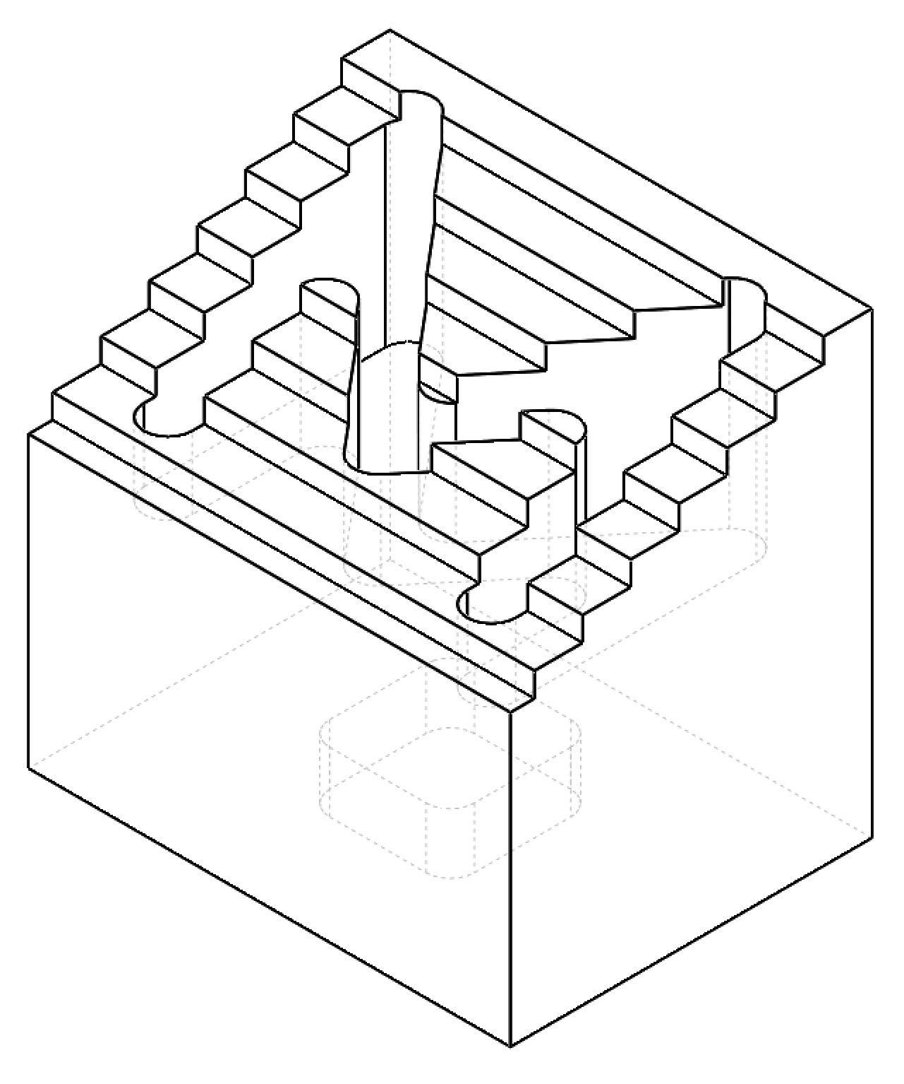
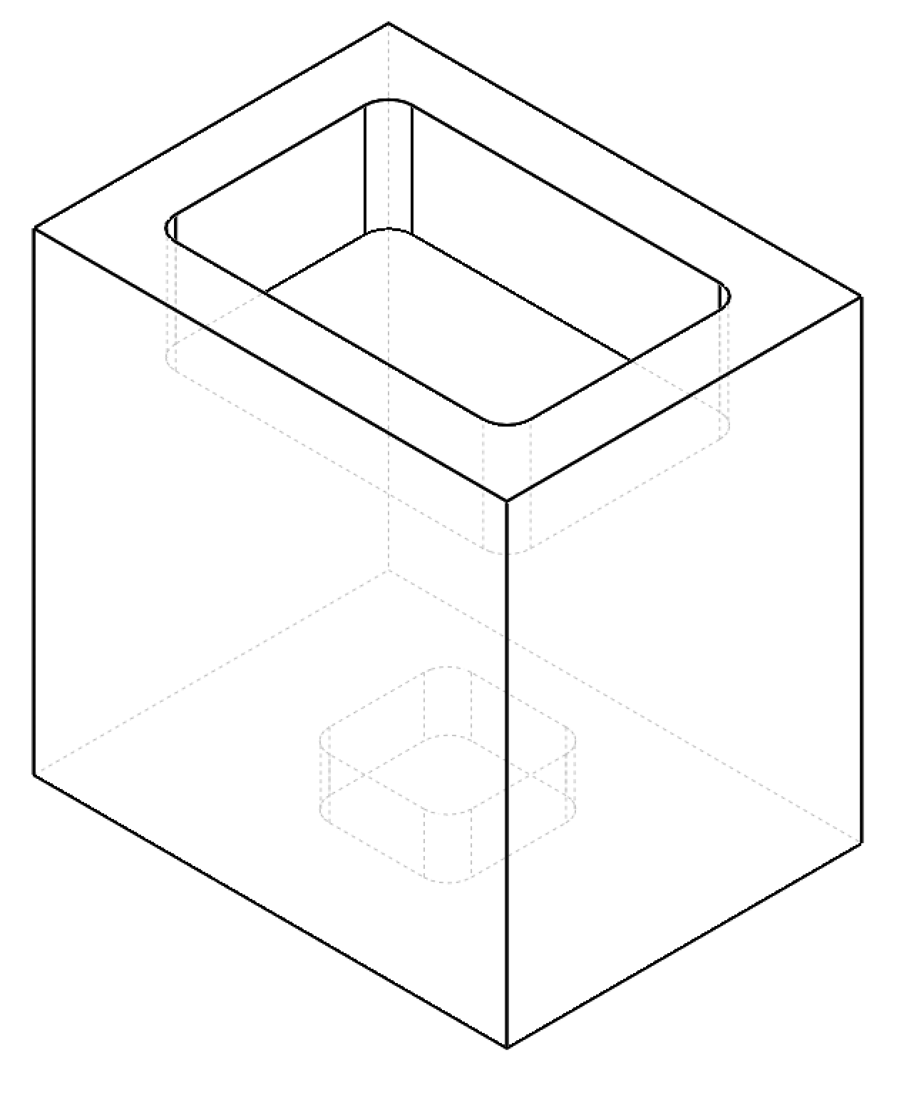
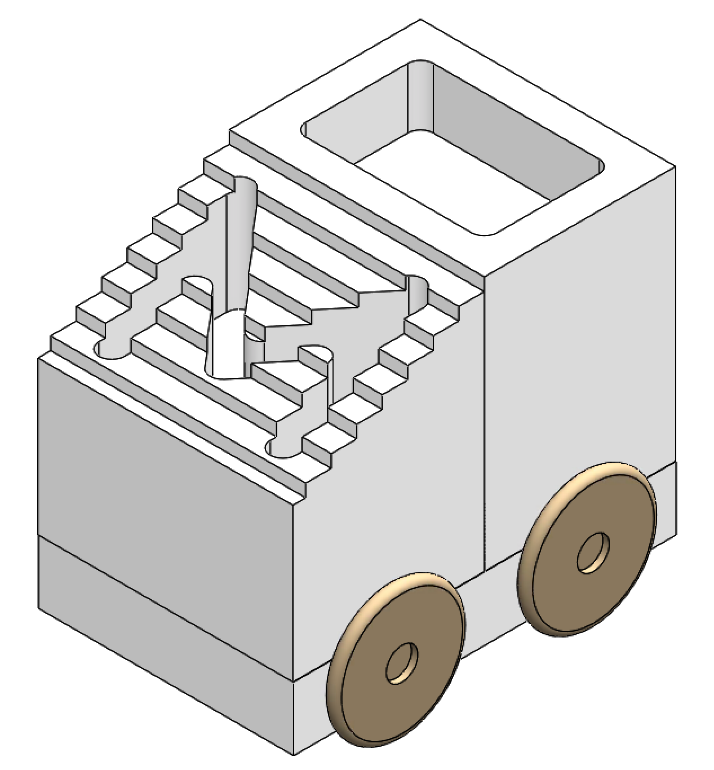
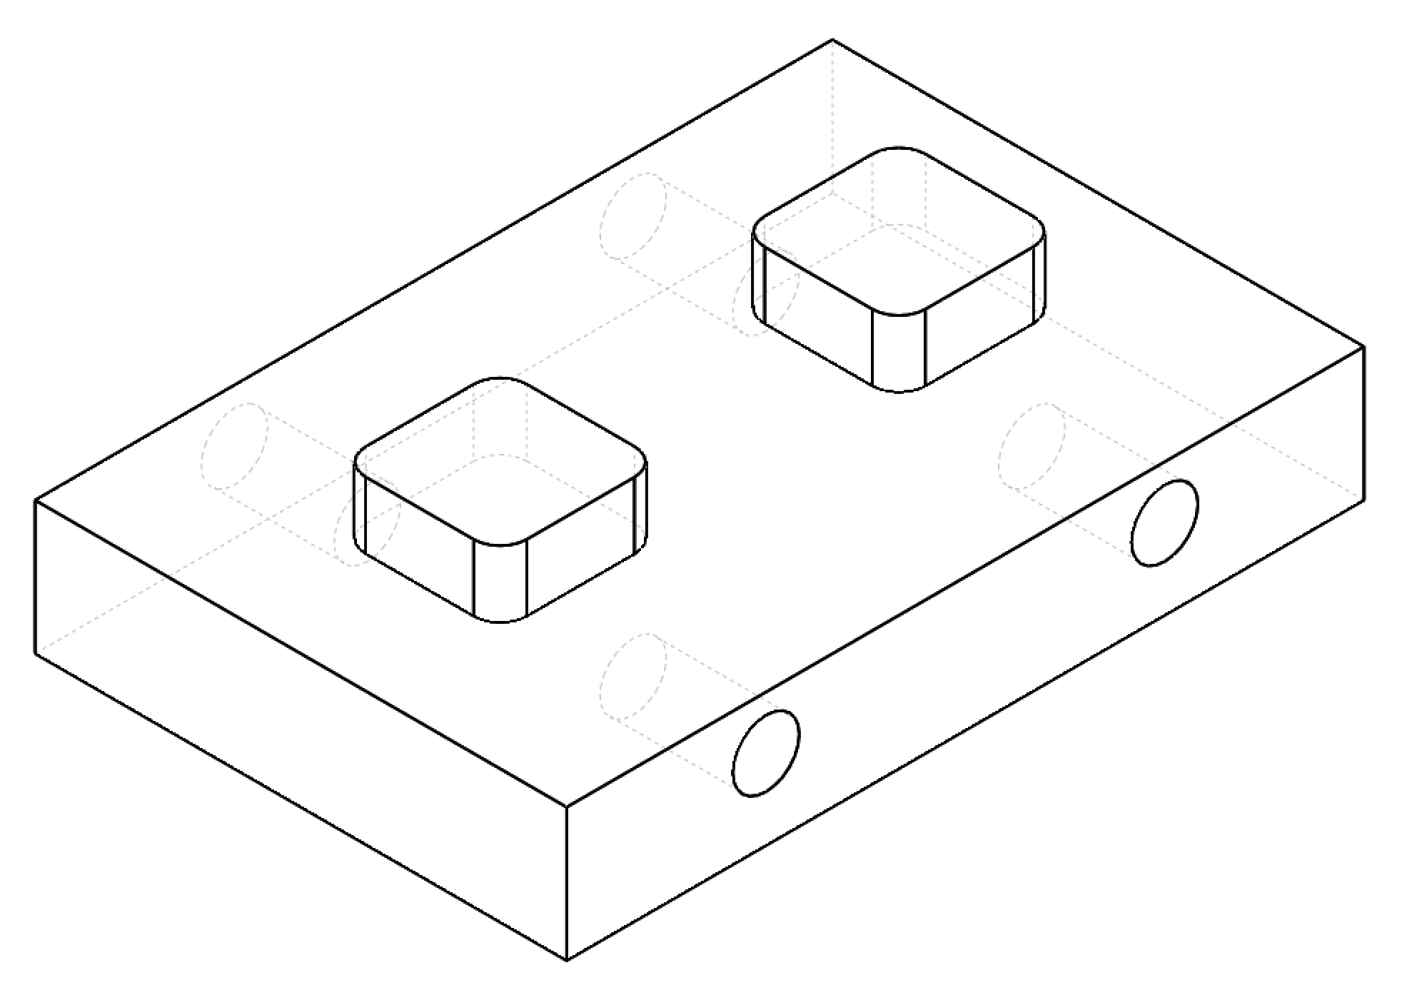
Assembly and individual parts
Part 3 - Trunk
Part 2 - Cabin
Part 1 - Chassis
Wheels

Slide 3
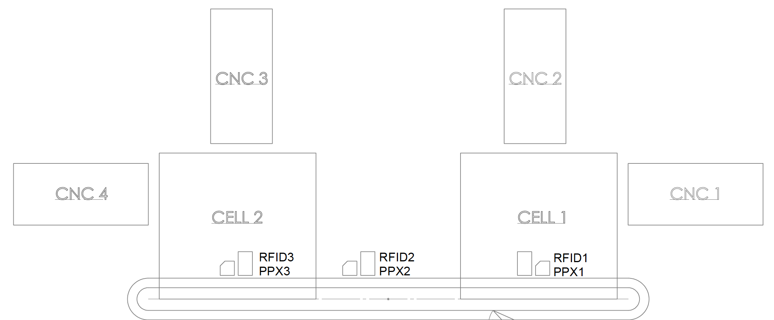
Testbed floor plan
LEGEND
M - Mechanical gripper
C - Vacuum gripper
M
V

Slide 4
Parts and process numbers
Process # | Part 1 - Chassis | Part 2 - Cabin | Part 3 - Trunk
0 | Raw material | Raw material | Raw material
1 | Machined top (CNC1 – Vacuum) | Machined bottom (CNC2 – Mechanical) | Machined bottom (CNC2 – Mechanical)
2 | N/A | Inspected | Inspected
3 | N/A | Flipped | Flipped
4 | N/A | Machined top (CNC3) | Machined top (CNC4)
5 | Inspected (finished) | Inspected (finished) | Inspected (finished)

Slide 5
Flow diagram
Start
Assign Part # at RFID 6
Inspection at Camera 1
Update to process 1 at RFID 1
Machined in CNC 1
Part 2/3
Read part/process # at RFID 1/3
Part 1
Machined in CNC 2
Update to process 2 at RFID 2
Flip part in Cell 1
Update to process 3 at RFID 1
Update to process 1 at RFID 1
Inspection at Camera 2
Update to process 4 at RFID 3
Machined in CNC 3/4
Inspection at Camera 1
Update to process 5 at RFID 4
End
Update to process 5 at RFID 2

Slide 6
Machining: Part 1 - Chassis
Process #
0 | Raw material
1 | Machined top
2 | N/A
3 | N/A
4 | N/A
5 | Inspected (finished)
Process #1: top surface face milling
Vacuum gripper to CNC 1
Tool: ¼” end mill
Process: 1) 0.25mm Facing 2) 0.2” deep passes Area Milling
Time: 1 + 20 minutes
Post processing: wheel holes drilling
Manual
Tool: ¼” drill
Process: 4 x 0.5” holes
Time: 4 x 2 minutes
0.5”
0.2”
0.79”
(120mm)
2”
(50.8mm)
3”
(76.2mm)

Slide 7
Machining: Part 2 - Cabin
Process #
0 | Raw material
1 | Machined bottom
2 | Inspected
3 | Flipped
4 | Machined top
5 | Inspected (finished)
Process #1: bottom surface pocketing
Mechanical gripper to CNC 2
Tool: 1/8” end mill
Process: 5mm deep rectangular cut
Time: 1 minute
Process #4: top surface stepped face milling
CNC 3
Tool: 5/16” drill
Process: 1/8” deep passes
Time: 20 minutes
1.5”
2”
2”
1.5”

Slide 8
Machining: Part 3 - Trunk
Process #
0 | Raw material
1 | Machined bottom
2 | Inspected
3 | Flipped
4 | Machined top
5 | Inspected (finished)
Process #1: bottom surface pocketing
Mechanical gripper to CNC 2
Tool: 5/16” end mill
Process: 5mm deep rectangular cut
Time: 1 minute
Process #4: top surface pocketing
CNC 4
Tool: ¼” drill
Process: 12mm deep rectangular cut
Time: 20 minutes
1”
1.5”
12mm
2”
2”
1.5”

